Slide 1
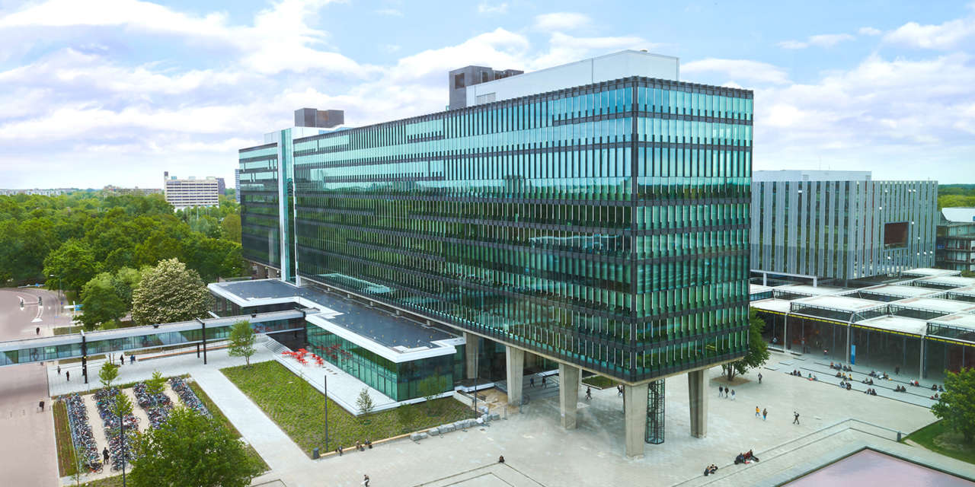
Design Architecture and Scope
09/03/2023
Elham Honarvar, Project manager
Mechatronic System Design
Autonomous Referee

Slide 2
Progress of the project
Needs
Mission
Requirements
Flow Diagram - Game States
Additional Constraints
Approach Search
Feasibility of different design solution
Technologies Search
TRL of different Technologies
Logical Decomposition
Define Scope
PoC
Solution Design

Slide 3
Project Activities
Second version of PMP will be provided
Feasibility check of different input data
 | Week |  |  |  |  |  | Final week
Project activities schedule | 1 | 2 | 3 | 4 | 5 | 6 | 7
 | 06/02-13/02 | 13/02-19/02 | 20/02-26/02 | 27/02-05/03 | 06/03-12/03 | 13/03-19/03 | 20/03-24/03
Project Management Plan creation |  |  | Final version
2021-2022 MSD project documents review
Hardware and software options evaluation
Project scope definition
New requirements creation
Feasibility Check of input data
System Architecture definition
Software creation and integration
Systems test
Documentations and main delivarables |  |  |  |  |  |  | Final Presentation
Weekly meeting with stakeholders

Slide 4
Needs and Expectations
1.The AutoRef should conduct a 5 mins match with 2 vs 2
2. The AutoRef should be fair about the decisions it made
3. The AutoRef should be reliable, work in different stadiums, independent of area of gameplay and duration of the match
4. A final delivery should match with the team limited resources
5. Proper documentation should be provided
6. Personal learning goals of the team members should be achieved
7. The system should have logs of the match and can show evidence of violations when needed
8. The system can communicate with the human referee, have feedback, and assist during the match
9. The project should build on the work of the previous years
10. The project should allow the next generation to work on top of this year's results

Slide 5
Mission
Pre-mission | Mission | Post-Mission
System mounting to environment | Check the kick-off procedure | Ensure and handle the data related to the game is safe
Communication with related parties before match (Refbox etc.) | Set time and start the match | Shut Down the system
Turn on the system | Monitor the whole match and game states
 | Record the last position of ball in case of connection with field line
 | Detect rule violation
 | Decision-making algorithm (award and punishment system such as penalty or yellow card)
 | Help human referee if needed
 | Log and show evidence for game calls
 | Stop the game when needed and check procedures before starting again.
 | End match
2022 MSD AutoRef Project

Slide 6
Functional Requirements
Performance Requirements
AutoRef shall be aware of the time and use this information to start and stop the match.
AutoRef shall comply with MSL Rulebook while deciding violations and following procedures
AutoRef shall decide an award or punishment regarding the violations and procedures during the match
AutoRef shall gather data and can comprehend its reliability
AutoRef can estimate game states by using data gathered during the match
1.All hardware regarding the AutoRef shall be compatible with MSL organization environment.
2.AutoRef shall give permission to users to modify pre-defined game rule parameters and/or deploy some/all the rules.
3.AutoRef shall be connected to Refbox via TBD with maximum TBD latency.
4.AutoRef shall be capable of sending/receiving digital ON/OFF signals to/from AutoRef.
5.AutoRef shall record/store game data as well as log history.
6.AutoRef shall allow users to use stored data and download it.
7.AutoRef shall upload game data automatically a TBD deposit and ensure its safety during the process.
8.AutoRef shall acquire data in each TBD second and estimate game states max TBD cm for positions and TBD cm/s for velocities relative to the field line coordinate system.
9.AutoRef shall decide a violation within TBD seconds.
(TBD=To Be Decided)

Slide 7
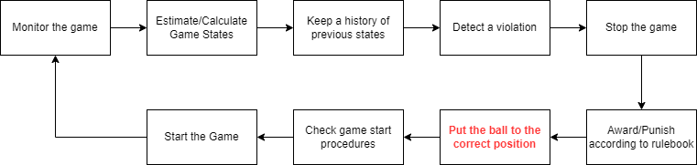
Flow diagram
By watching some of the real matches of Tech United during the tournaments, a flow diagram of the of the mission process is created

Slide 8
Updated Game states
The game states can be listed as follows:
The positions and velocities of soccer robots for each delta-T
Ball engagement of each robot
Robot and team id
Robot’s pose – angular orientation
Positions of the lines and specific areas in the field.
The field line position the ball has touched last before leaving the play area.
The time elapsed between the first and last touch of the robot during dribbling.
The position and velocity of the ball.
Time

Slide 9
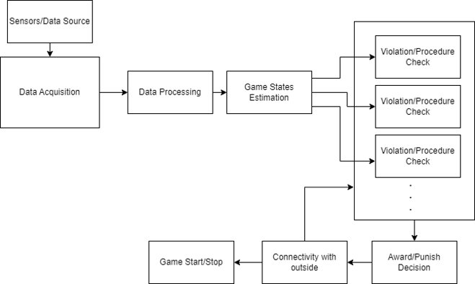
Logical Architecture
Main focus is on Data Acquisition
Adaptability of the algorithm to any rule change

Slide 10
Data collection specification
Reliable data
Comprehensive view of field
Availability
Easy to record and reuse
Accuracy
Cover the required game states

Slide 11
Data Collection Approaches
Sensors Mounted on top of each player
Data Fusion for data collection
Data from teams (Tech United Data)
Fixed Independent Sensors Mounted on the Stadiums

Slide 12
Technological readiness level of data collection methods
 | Radar | Lidar | Camera | Inertial | Temprature
Accuracy | 0 | 1 | 0 | 1 | NA
Availability | 0 | 0 | 1 | 0 | NA
Easy to use | 1 | 0 | 1 | 0 | NA
View of the field | 1 | 1 | 1 | 0 | NA
Game states covering | 0 | 1 | 0 | 0 | NA
Data Processing complexity | 1 | 0 | 0 | 1 | NA
Notes:
These sensors are highly dependent on the material of the object. Thermal conductivity is required for all objects. if a robot or ball is made of metal or some other material with a high thermal conductivity, it may conduct heat differently than the air or other objects around it, leading to a detectable temperature difference

Slide 13
Data Acquisition strategy is selected as using multiple cameras around the stadium
For the starting point to set a integration delivery, a corner kick game start procedure will be used because:
The procedure is simple
Similar with other game starting procedures.
Camera technology is less complex, and hardware is reachable.
Implementation has a direct effect on the game, since the human referee does not measure distances during a real match.
The procedure is not directly related to any rule violations that makes it easy to integrate with future/past implementations.

Slide 14
Scope of the design
Detect any violation occurring when starting the game with a corner kick within 1 sec with 85% accuracy (true detections)
The game states that needs to be detected are:
The positions of soccer robots for each delta-T (sampling time TBD) relative to the coordinate system
Positions of the lines that defines the field relative to the coordinate system
The position of the ball

Slide 15
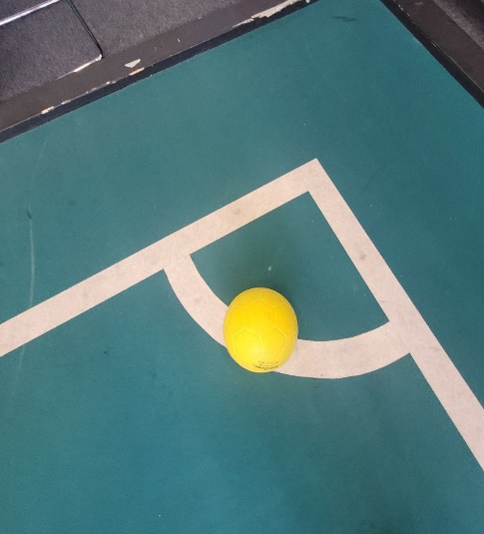
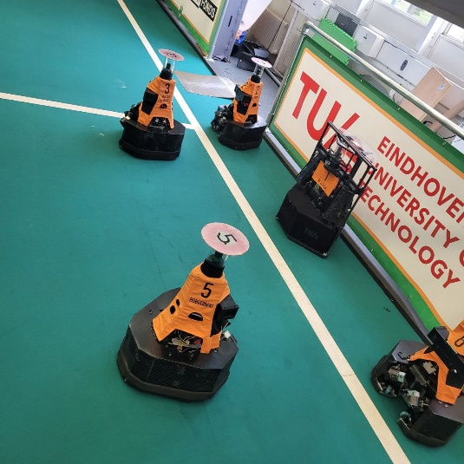
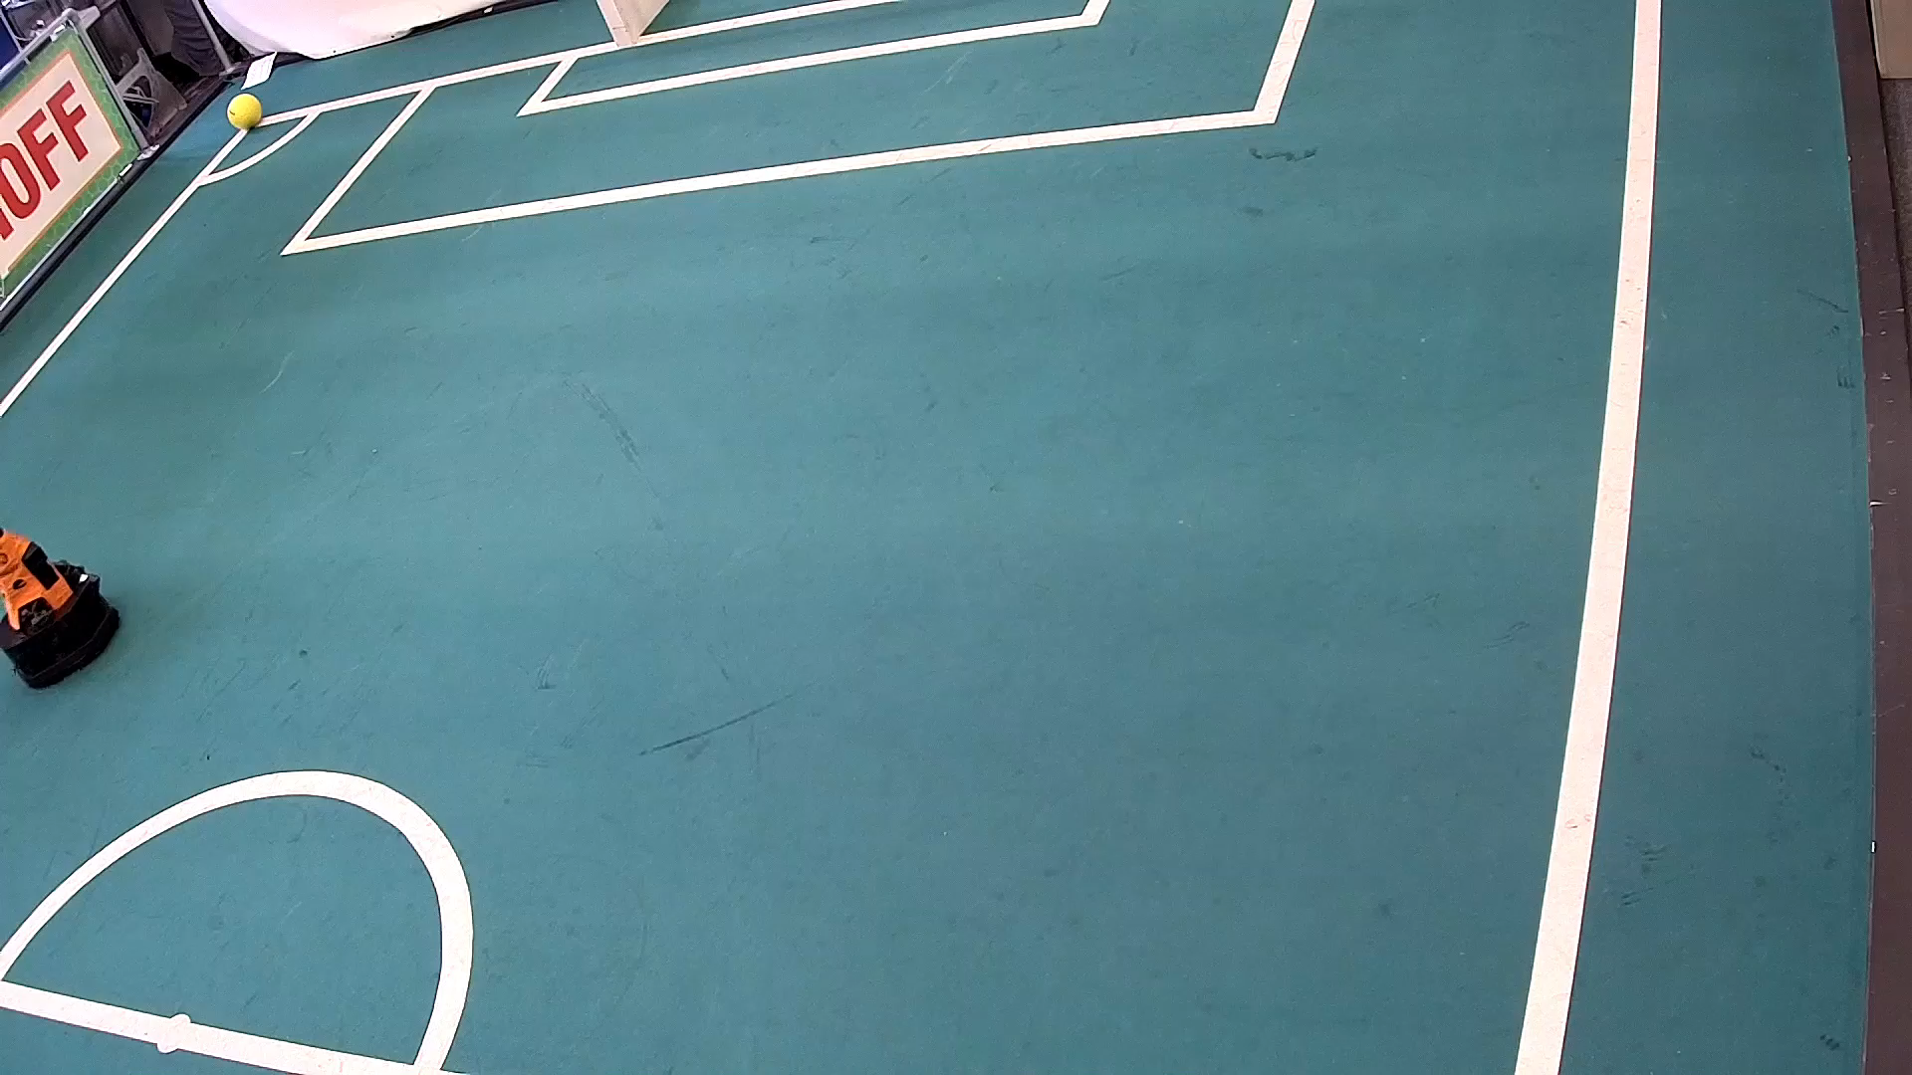
Scope
Use a stationary camera for collecting the data.
Data collection (Videos) of robots and stadium
Analyze different methods for preprocessing the videos and images
Analyze different methods for detecting lines, ball and players
Detect if the rule is violated using a Decision making Algorithm
Log the event
2022 MSD AutoRef Project

Slide 16
Thank You

